Slide 1

CS470: Restaurant Database

Slide 2
Introduction
Fast food is a way of life for most of the population within United States, with good prices and fast service it’s no wonder it is so ingrained within our society. From a customer perspective there’s no worry about ever having to go hungry, however the inner working of a fast food location are much more complex with a lot of information to keep track of. Our group looks to try to understand what makes fast food restaurant tick and running smoothly to the naked eye. We decided to look at these key points:
Employees (Position Titles, Pay, Name, ID, Address, Restaurant Location)
Restaurant (Name, Location, # of Employees,ID)
Menu Items (Name, Price, Quantity, Availability Status, Restaurants served at)

Slide 3
Schema Requirements
Restaurants contain (ID #,Name,Location,# of employees)
Employees contain (ID #, Name, Address, ID# of the position they hold)
Each Position has (ID#, Position Title, Pay)
Each Menu Item should have ( Restaurant ID# of where it’s served, Type of food i.e. Food or drink, Price, Count of the items on hand, Status of the item i.e. In stock, out of stock)

Slide 4
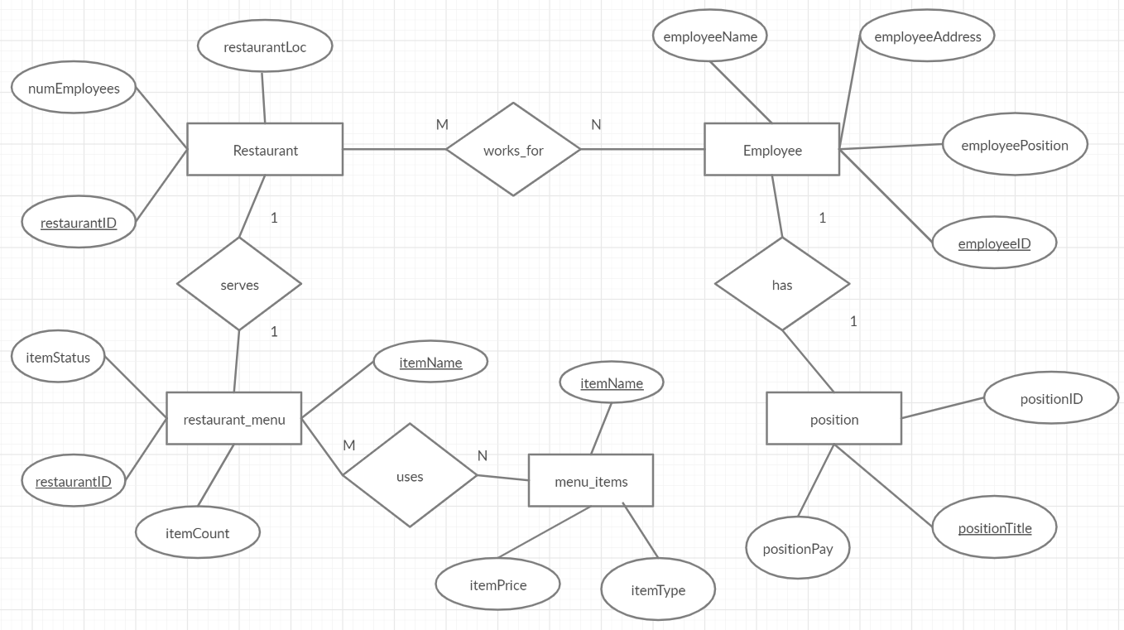
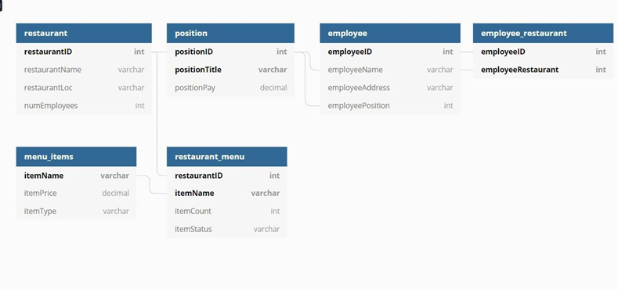
Schema diagrams
ER Diagram
Schema Diagram

Slide 5




Technical Summary
Database hosted & connected to using XAMPP
Schema, Procedures, and Entries made using PHP and MySQL
Model made using Visual Studio & C++/CLI

Slide 6
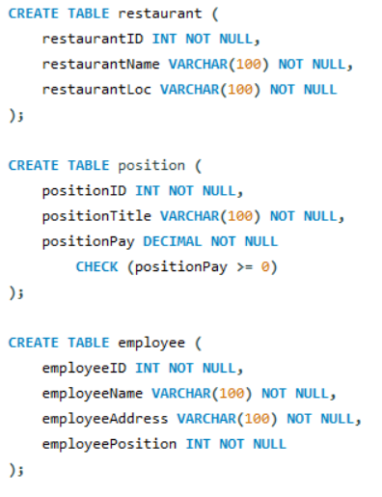
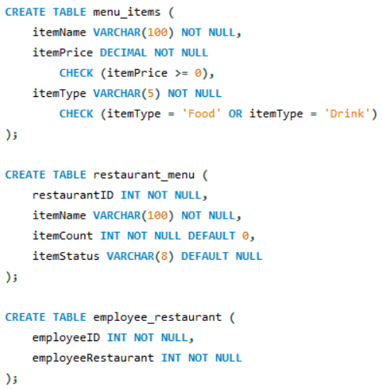
DDL Process
Tables in MySQL: restaurant, position, employee, menu_items, restaurant_menu, employee_restaurant

Slide 7
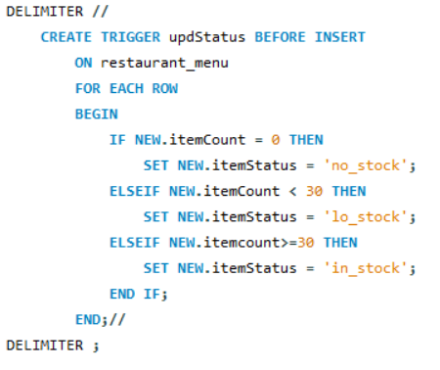
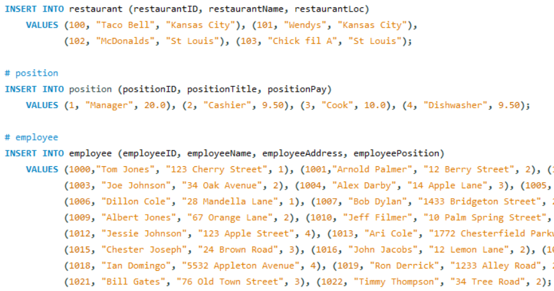
Data Insertion

Slide 8
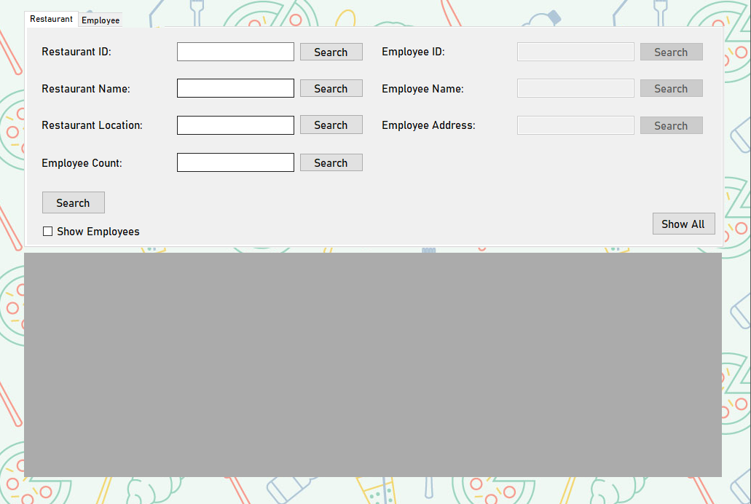
Application Process
All functions are organized into the Restaurant, Employee, and Menu tabs
Connection string stored in app.config
Individual and Global search
All functionality is based in procedure calls
SQL Injection prevented because user is not allowed to input strings with ();’ characters.

Slide 9
Future Scope
Additional functionality
Insert, Delete, Update
Global search supports empty fields (LIKE ‘%’)
Login & Role system
Secure, encrypted login
Limit functionality according to one’s role
Support more item categories
Categories for various utility items & supplies

Slide 10
Deficiencies
Room to improve security & implementation
Encrypt app.config
By restricting characters to prevent SQL injection, we also limit the user’s ability to search the database (even though we don’t expect entries to have those characters in them)

Slide 11
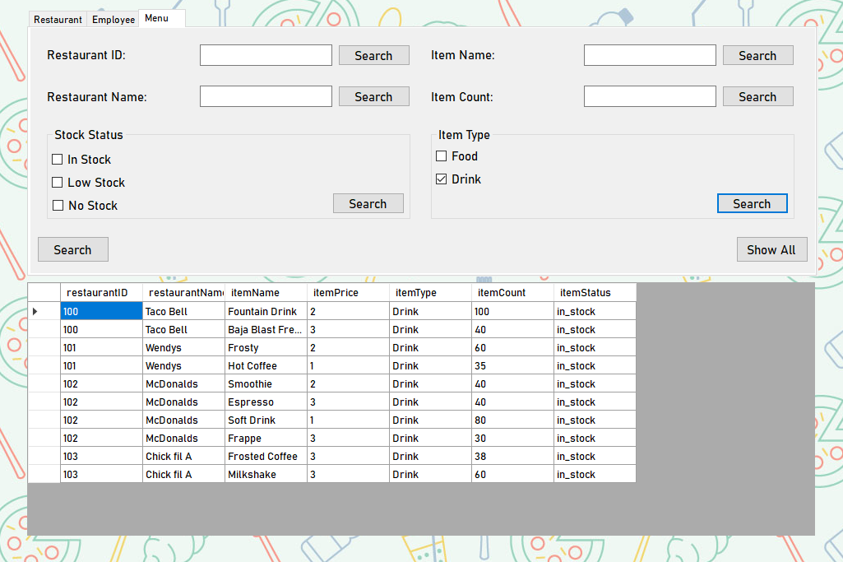
Conclusion
Our current solution for our model allows for users to access and search for information within our database in a secure way, so long as a connection is available.
In the future, we would add more item types, model functionality, and improve the way we implement our security

